Slide 1
Business Analytics
Logistic Regression Using R

Slide 2
Outline
Logistic Regression
Linear Vs Logistics Regression
Types of Logistic Regression
Binary Logistics Regression Using R

Slide 3
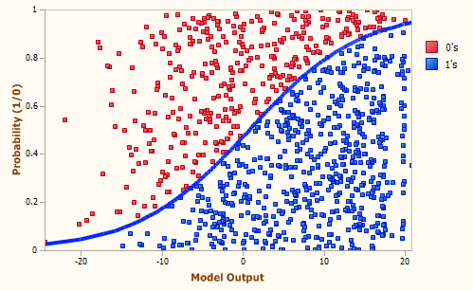
Logistic Regression
A statistical approach and Supervised Machine Learning Algorithm
Used when the dependent variable is categorical type
Used for Classification and is based on the concept of probability

Slide 4
Linear Vs Logistic Regression
Linear Regression | Logistic Regression
Continuous Response Variable | Categorical Response Variable
Predicted values are the Y (Dependent) Variable at the given values of the X (Independent) variable(s) | Predict the probability of Y occurring given values of the X (Independent) variable(s)
Graph is straight line | Graph is S-Curve

Slide 5
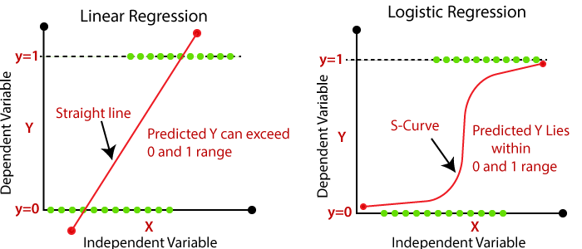
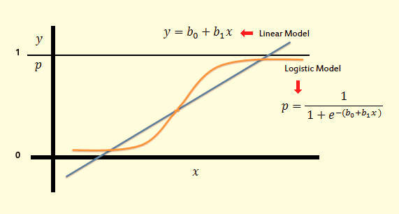
Linear Vs Logistic Regression…

Slide 6
Type of Logistic Regression
Logistic Regression
Binary
Nominal
Ordinal
Response Variable has Two categories
Go / not-go,
pass/fail,
buy/doesn’t buy
male/female
Response Variable has more than two unordered categories
Married / Widowed / Divorced
Hair / Brown hair / Blonde hair
Sunny / Rainy / Cloudy
Response Variable has ordered categories
Poor / Good / Excellent
Dissatisfied / Neutral / Satisfied
None / Mild / Severe

Slide 7
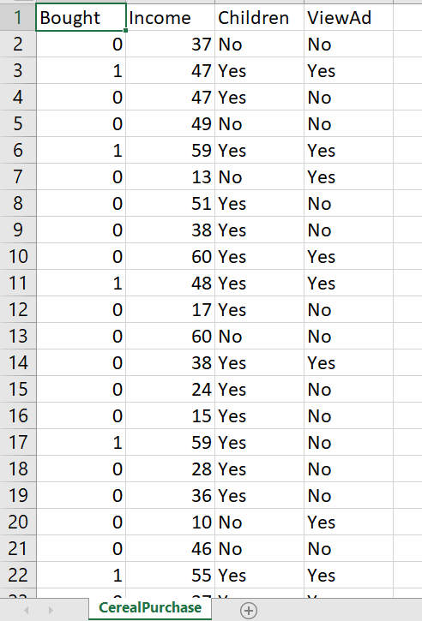
Binary Logistic Regression Using R: Example
A marketing consultant for a cereal company investigates the effectiveness of a TV advertisement for a new cereal product.
The consultant shows the advertisement in a specific community for one week.
Then the consultant randomly samples adults as they leave a local supermarket to ask whether they saw the advertisements and bought the new cereal.
The consultant also asks adults what their annual household income is.
The consultant wants to know who will bought the cereal based on the collected data.
Data file → “ CerealPurchase.csv”

Slide 8
Binary Logistic Regression Using R: Example…
Load the data
CerealPur <- read.csv(file.choose(), header = TRUE)
View the data
View(CerealPur)
Fit the Model
BLG1 <- glm(Bought ~ Income + Children + ViewAd, family = "binomial", data = CerealPur)
Get the Results
summary(BLG1)

Slide 9
Binary Logistic Regression Using R: Example…
Assessing the goodness of Model fit
Deviance (Null Vs Residual)
Akaike information criterion (AIC)

Slide 10
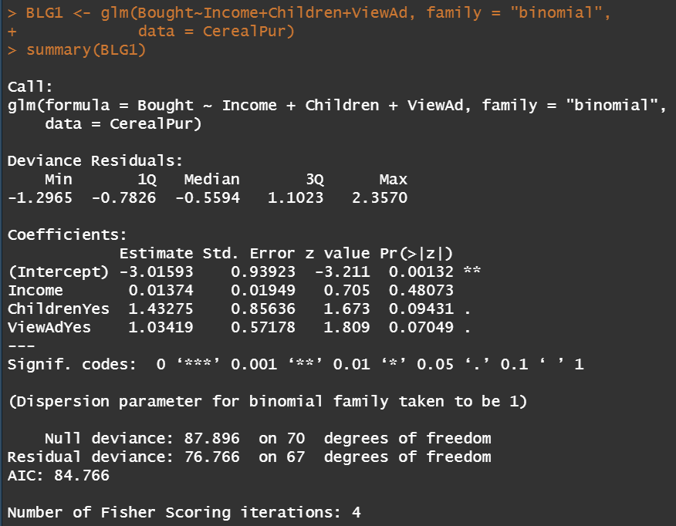
Binary Logistic Regression Using R: Example…
Assessing the goodness of Model fit
Deviance (Null Vs Residual)
Null deviance: when model has only "CONSTANT TERM“
Residual deviance: Actual Fitted Model
The Smaller the Deviance value better the model is

Slide 11
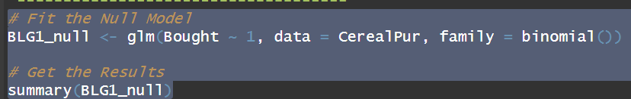
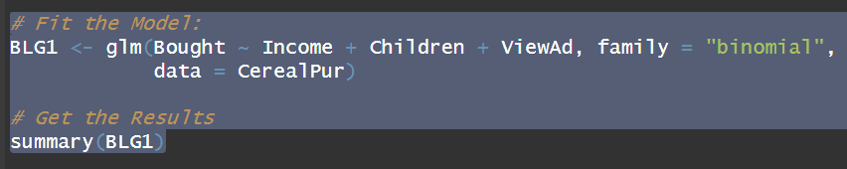
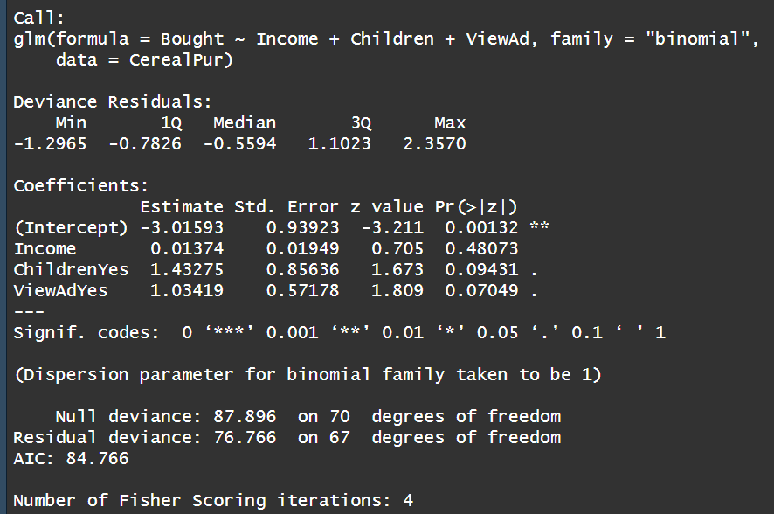

Binary Logistic Regression Using R: Example…
Assessing the goodness of Model fit
Akaike information criterion (AIC): Null Vs Fitted Model
Null Model
Fitted Model

Slide 12
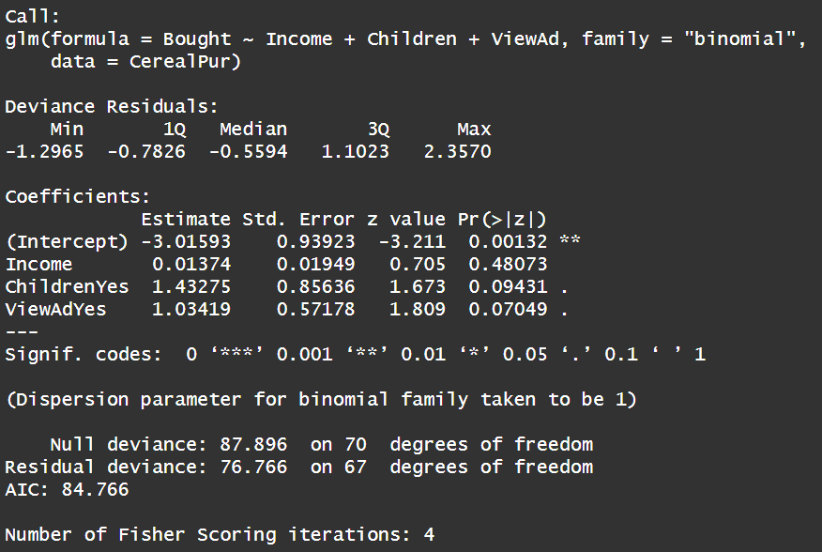
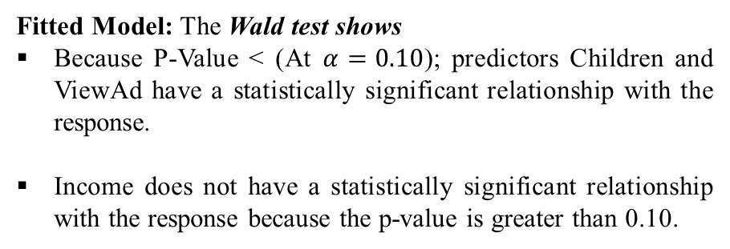
Binary Logistic Regression Using R: Example…
Check the Significance of the Predictors
Fitted Model: The Wald test shows
Because P-Value < (At $α=0.10$); predictors Children and ViewAd have a statistically significant relationship with the response.
Income does not have a statistically significant relationship with the response because the p-value is greater than 0.10.
The consultant may want to refit the model without the income variable.

Slide 13
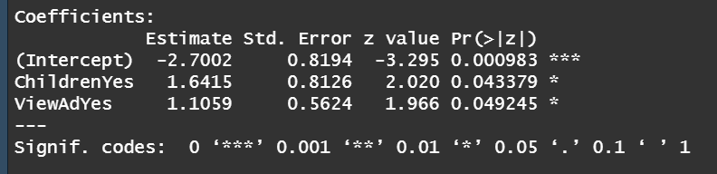
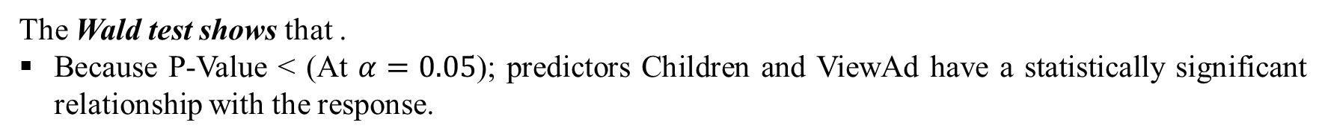
Binary Logistic Regression Using R: Example…
# Model-2:
BLG2 <- glm(Bought ~ Children + ViewAd, family = "binomial", data = CerealPur)
summary(BLG2)
The Wald test shows that .
Because P-Value < (At $α=0.05$); predictors Children and ViewAd have a statistically significant relationship with the response.

Slide 14
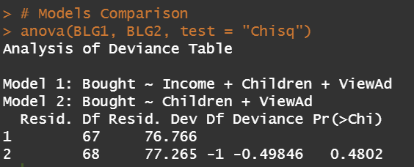
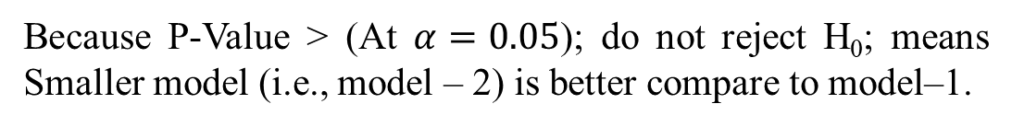
Binary Logistic Regression Using R: Example…
Models Comparison (Model-1 Vs Model-2)
If a pair of models is nested (i.e. the smaller model is a special case of the larger one) then we can test
H₀ : smaller model is true
H₁ : larger model is true
Because P-Value > (At $α=0.05$); do not reject H₀; means Smaller model (i.e., model – 2) is better compare to model–1.

Slide 15
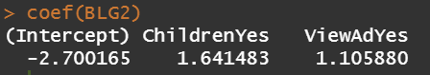
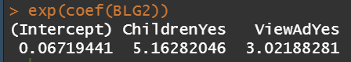
Binary Logistic Regression Using R: Example…
Odds Ratio
An odds ratio (OR) is a statistic that quantifies the strength of the association between two events, A and B.
OR = 1 → no higher or lower odds of the outcome happening (NO effect on outcome) (or Event is as likely to happen in both groups)
OR > 1 → there is a greater likelihood of having the outcome ( or Event is more likely to happen than base group)
OR < 1 → there is a lesser likelihood of having the outcome (or Event is less likely to happen than base group)
Model Parameters
coef(BLG2)
Odds Ratios
exp(coef(BLG2))
The odds ratio indicates that
adults with children are approximately 5.1628 times more likely to purchase the cereal than adults without children.
adults that saw the ad indicates that they are 3.0218 times more likely to purchase the cereal than adults who have not seen the ad.

Slide 16

QUESTIONS

